Slide 1
GSM
Voice Accessibility Analysis
Alberto Pérez Paz
August 2009

Slide 2
Contents
Introduction
Most common GSM accessibility issues
  Lack of Coverage
  Location Area Updating
  Overlapping
  Network Disconnection
    Network Congestion
    Protocol Error
    Unspecified
  Interference
  Missing Neighbor

Slide 3
Introduction
Accessibility is one of the most important network quality KPIs in mobile communications
This KPI is commonly known as CSSR (Call Setup Success Rate), representing the percentage of failed calls over total call attempts.
  CSSR = established calls / call attempts
    where:
        established calls = completed + dropped
        call attempts = completed + dropped + failed
A call is considered to be properly established when a TCH has been correctly assigned and speech samples start to be sent and received. Otherwise, it is considered as a failed call.
All the procedures taking place during call establishment can be reviewed in the Call Establishment Training

Slide 4
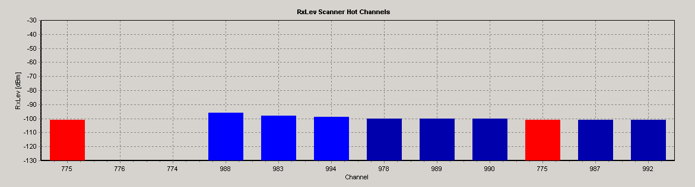
Lack of Coverage
On the NQDI GSM Scanner Tab -> Hot Channels, we can see the RxLev of the best server channels measured by the scanner
In this case, all BCCHs show a RxLev lower than -95 dBm
Regarding incar measurements, we have also to take into consideration that MS RxLev will show an approx. 10 dB attenuation
The actual sensitivity level is defined as the input level for which an appropriated performance in terms of error rates is met. The actual sensitivity level shall be less than a specified limit, called the reference sensitivity level
GSM standard (3GPP TS 05.05 ) specifies the MS reference sensitivity level as:
  -104 dBm for a GSM 900 MS
  -100 dBm for a DCS 1800 class 1 or class 2 MS
  -102 dBm for a DCS 1800 class 3 MS

Slide 5
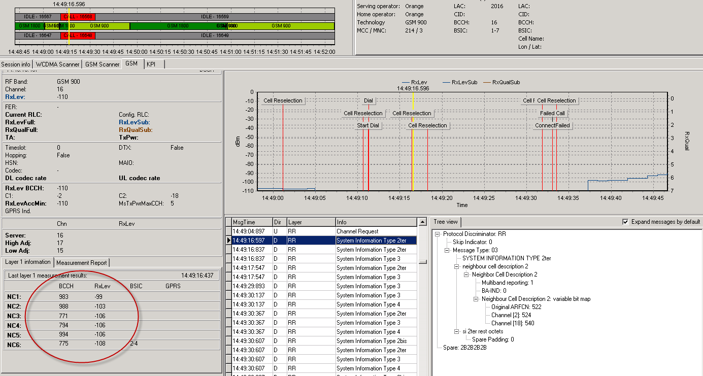
Lack of Coverage

Slide 6
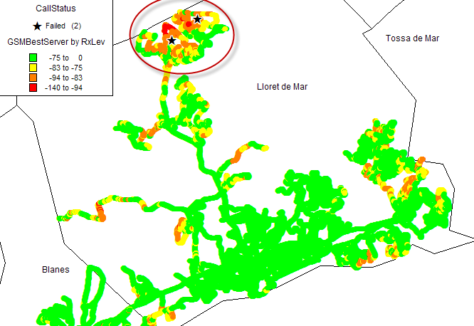
Lack of Coverage

Slide 7
Location Area Updating
Mobile radio access networks are divided into Location Areas
  Refer to Mobility Management Training
A MS is always registered in a specific LA; whenever a MTC call needs to reach the MS, paging messages are broadcasted all over the LA.
If the MS reselects on idle mode to a cell belonging to a different LA, a Location Are Updating process is immediately started.
Until the MS becomes properly registered in the new LA, all paging messages sent to that MS will not reach it, resulting in a MTC failed call

Slide 8
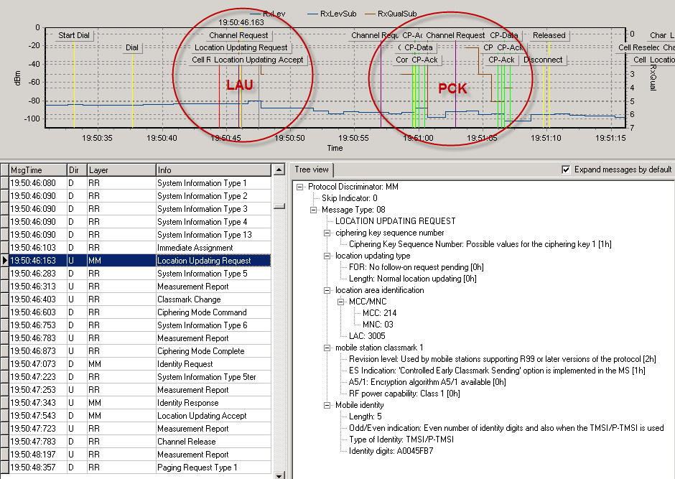
Location Area Updating

Slide 9
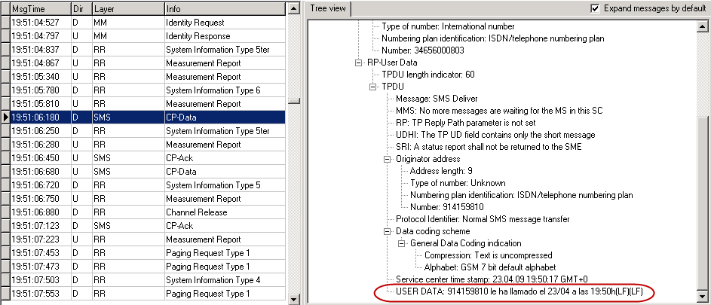
Location Area Updating
PCK: SMS message in which the operator notifies the user about an incoming call while the MS was unreachable

Slide 10
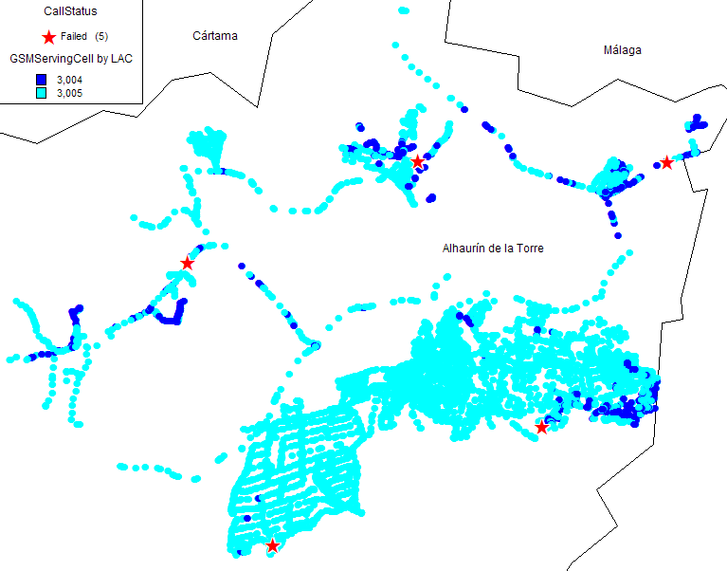
Location Area Updating
Location Area Updating due to overshooting:
  When a cell belonging to a different LA is reaching the MS as Best Server due to overshooting, it may also result in a MTC fail call

Slide 11
Overlapping
The term overlapping is used when several BCCHs are reaching the mobile with approximately the same RxLev, and therefore the best server channel is constantly changing due to the inexistence of a predominant one
This issue produces excessive cell reselections among these channels, resulting in MS unavailability (MS has to perform several low layer procedures in order to synchronize on every reselection)

Slide 12
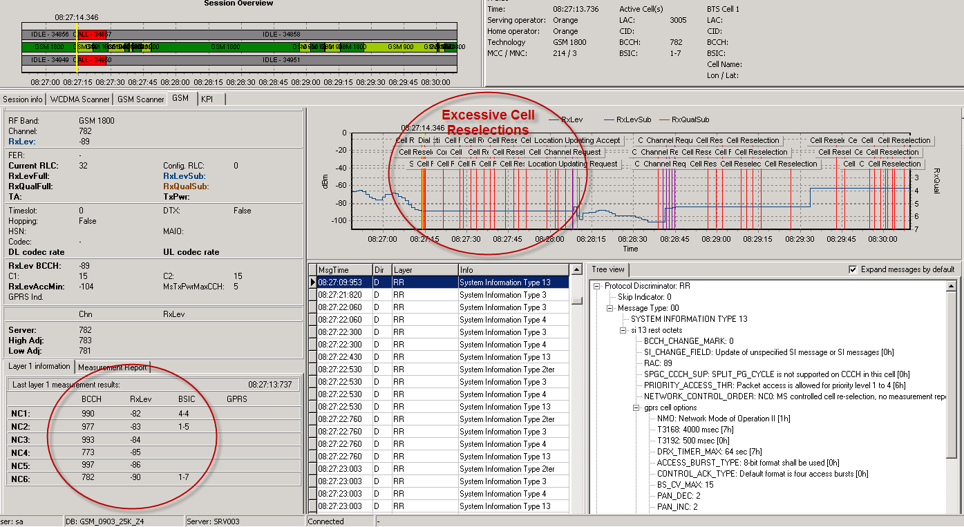
Overlapping

Slide 13
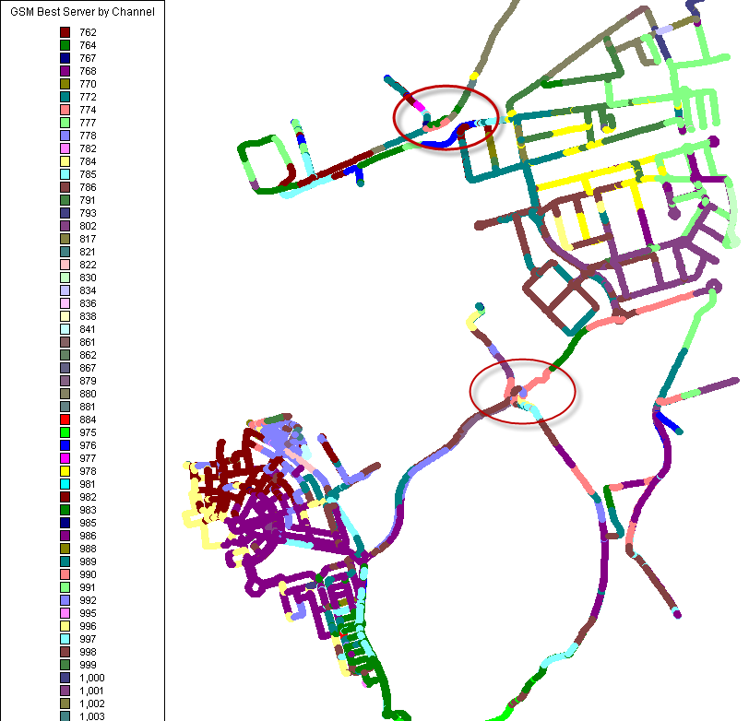
Overlapping

Slide 14
Network Disconnection
The network itself can disconnect an ongoing call due to several reasons:
  Network Congestion
    No circuit/channel available
    Switching congestion
  Protocol error / semantically incorrect message
  Unspecified

Slide 15
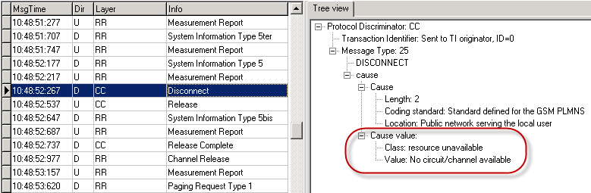
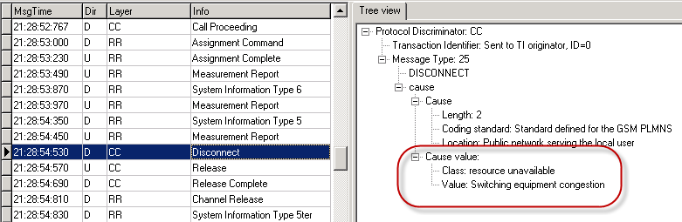
Congestion

Slide 16
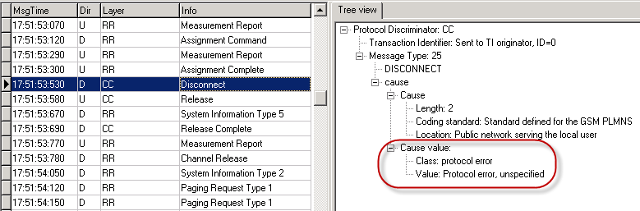
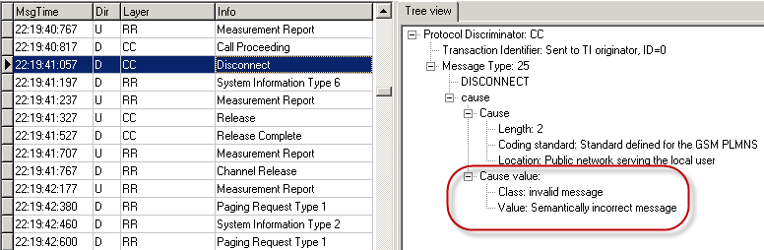
Protocol Error

Slide 17
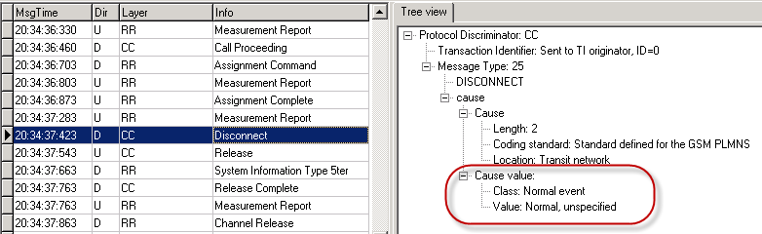
Unspecified
Sometimes the network disconnects the call without specifying any particular reason. Several issues might be happening:
  Coverage / Interference issues (must be checked)
  Transmission incidences
  BTS HW problems

Slide 18
Interference
The are two kinds of interference in GSM:
  Co-channel Interference: interference from the same channel
  Adjacent Channel Interference: interference from the low adjacent or high adjacent channels
GSM standard specifications requirements:
  The reference interference ratio shall be, for BTS and all types of MS:
    for cochannel interference C/Ic=9 dB
    for adjacent (200 kHz) interference C/Ia1=‑9 dB
    for adjacent (400 kHz) interference C/Ia2=‑41 dB
    for adjacent (600 kHz) interference C/Ia3=‑49 dB

Slide 19
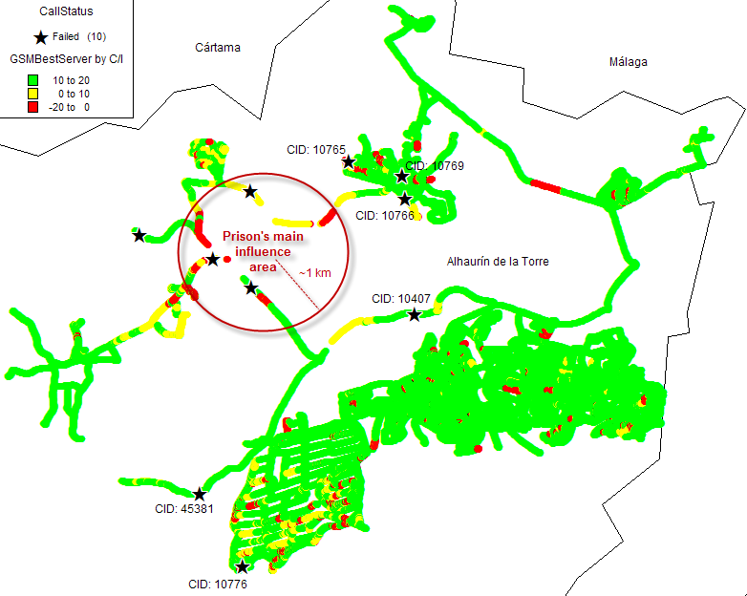
Interference
We can see on the scanner that all BCCHs show very poor C/I

Slide 20
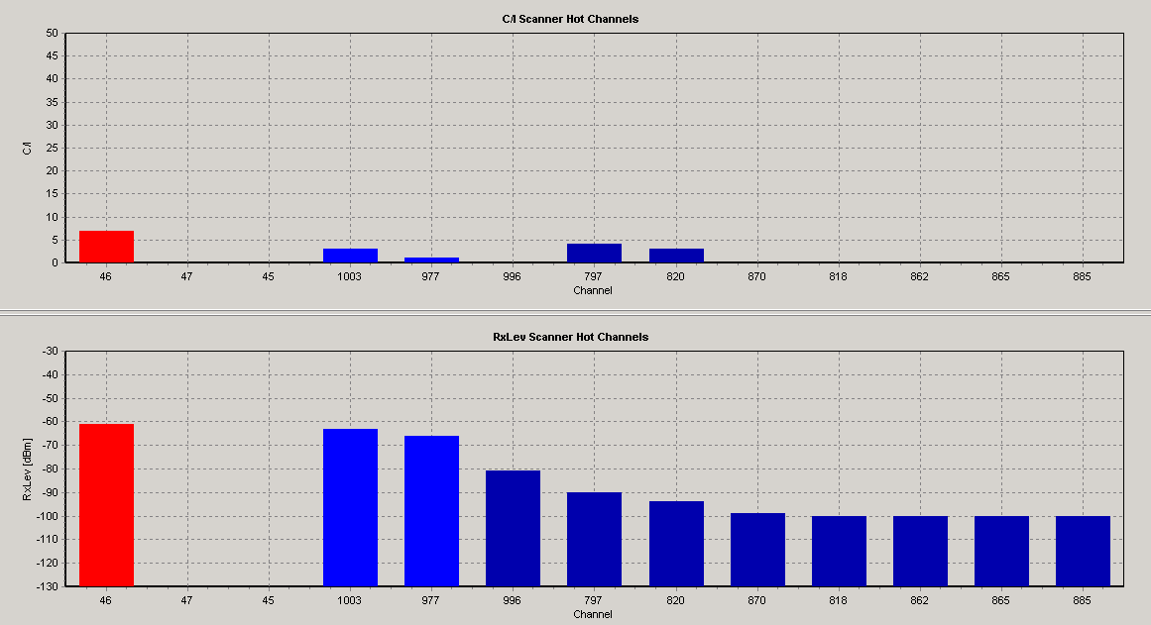
Interference
We can see on the scanner that all BCCHs, show very poor C/I

